Slide 1
Integrating and expanding a regional carbon monitoring system in the NASA CMS
Presenting: Kennedy and Neeti
A CMS Phase II (2012) activity
PI: Kennedy (Boston University). Co-Is: Powell (Montana State University) and Kane (University of Washington)

Slide 2
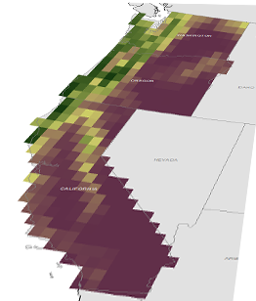
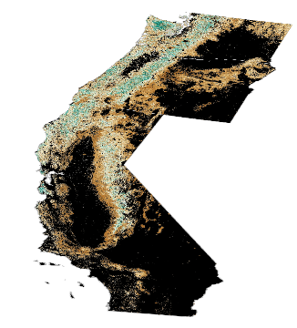
NASA CMS
Maps of biomass/flux:
Consistency and comparability
Global/National
Scale
Regional/
Local
Scale
Capitalize on:
Overlap in PLACE
Nearness in TIME

Slide 3
PLACE
TIME
Spatial patterns of agreement and disagreement to learn about maps
Temporal patterns to constrain spatial expectations
National-scale
Regional-scale

Slide 4
National scale maps
Methods
Map differences

Slide 5
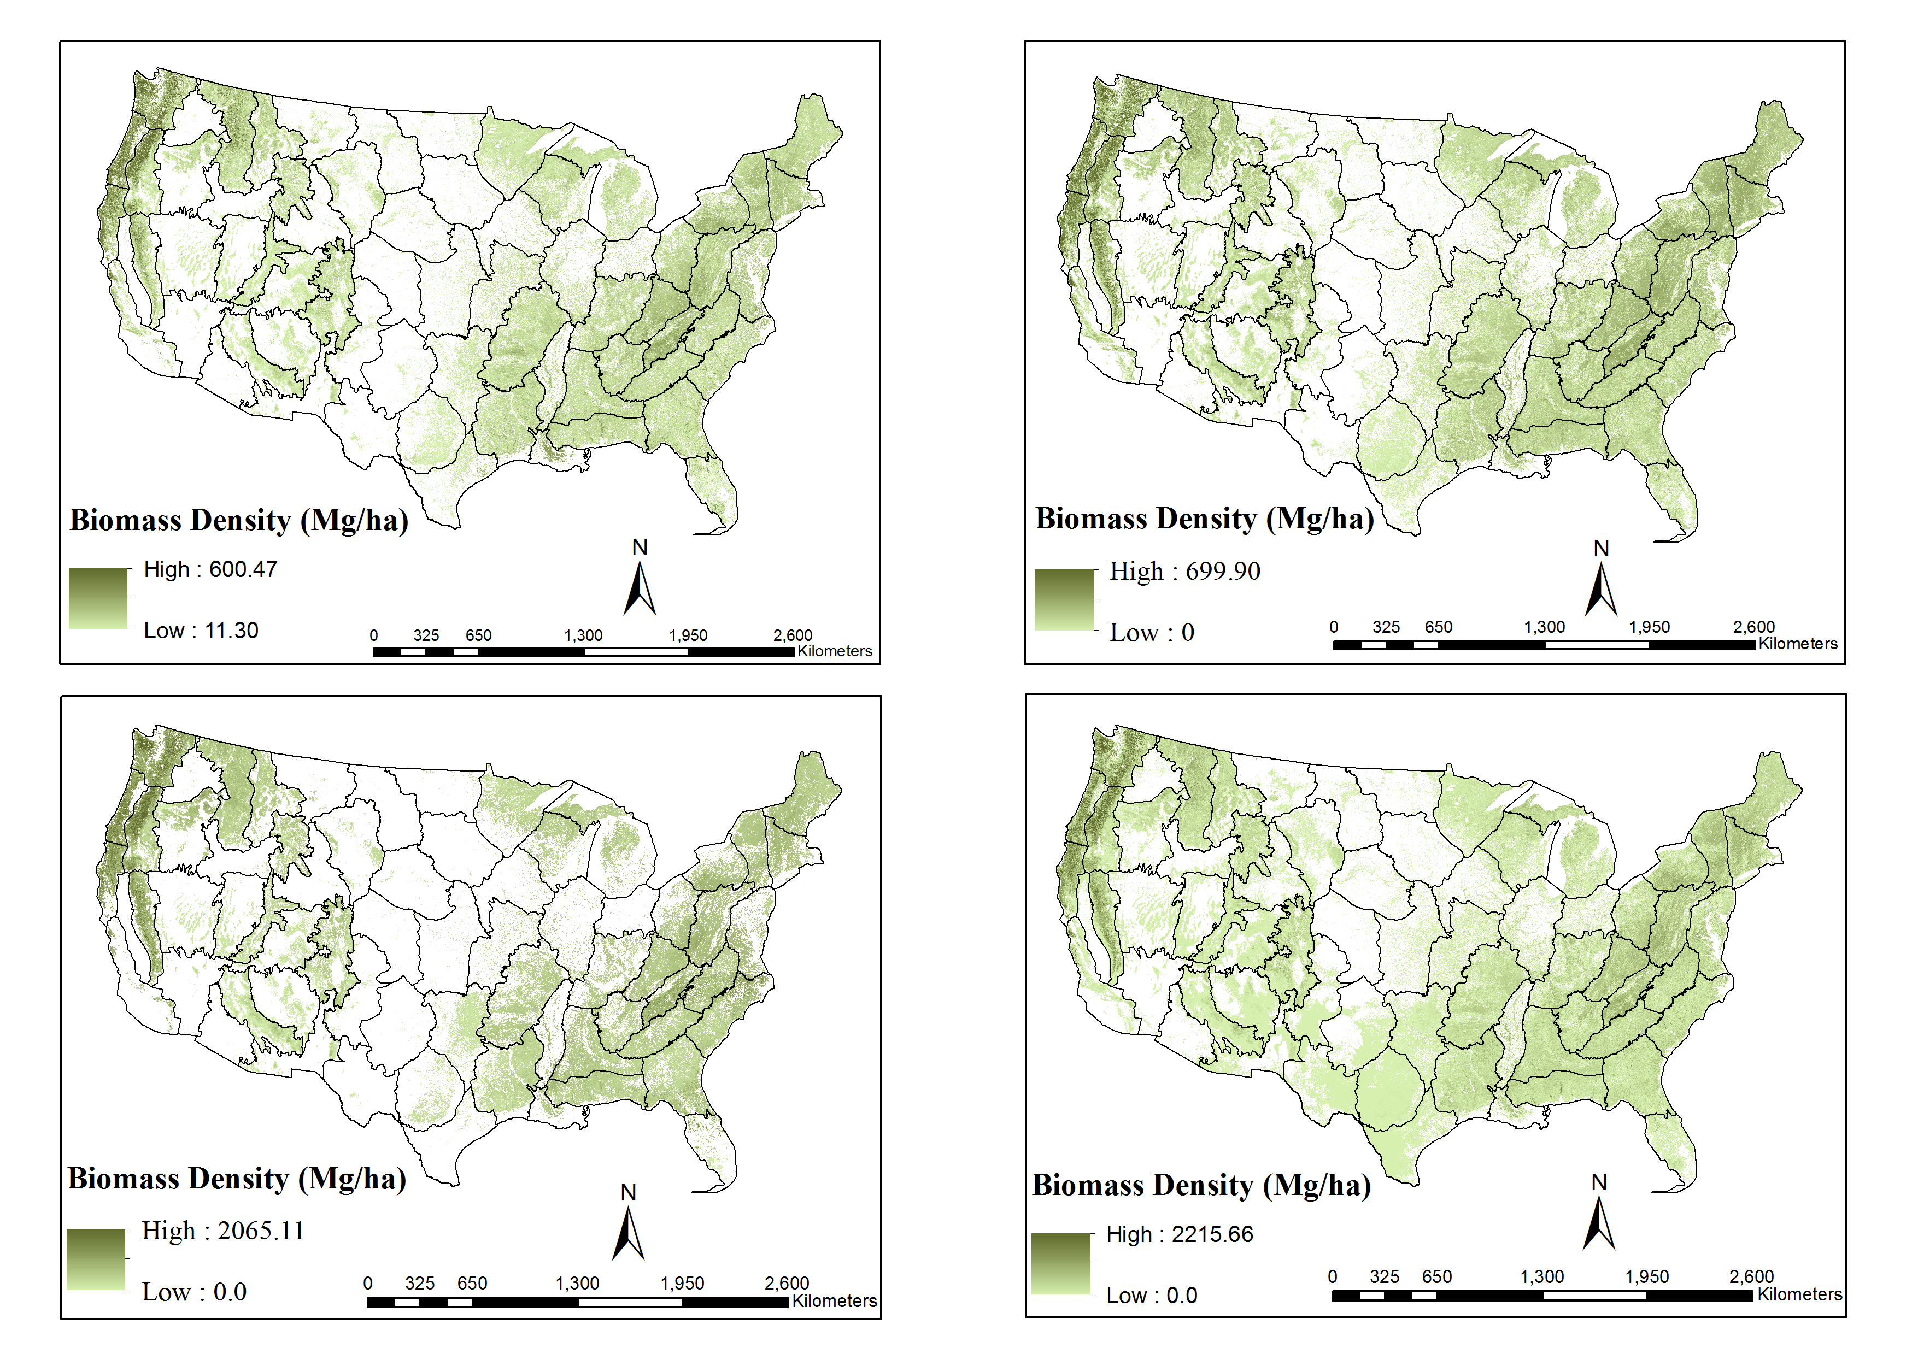
NASA CMS Biomass
Saatchi et al.
Kellndorfer et al.
Wilson et al.
Blackard et al.
Notes:
We are focusing on woody biomass. There is at least one (perhaps more now?) CMS biomass product at the national scale. Black lines denote mapping regions (which we’ll use later in the talk) that are roughly aligned with ecoregions – areas within which we expect to see roughly similar ecological and forest type conditions. Visually, the maps show essentially the same patterns at the national scale. If you look closely at some ecoregions, you can see differences – especially places where some map indicate biomass and others indicate none.

Slide 6
Methods
Initial step: Document key production methods
Finer resolution
Align products: Footprint and grain size
Coarser resolution
Use these to interpret later comparisons
Notes:
If maps diverge, it must be because of something different in their production, obviously. So the first step in a comparison is to clearly define key factors that drive the production of the maps – data sources, methods, etc.
Another key step: Align products spatially so that you’re comparing the same areas, both in terms of grain size and in terms of footprint (mask) of analysis. This is non-trivial housekeeping task.
Here are the details of how each maps were generated and potential sources of differences. These can help guide hypotheses of comparison – We can start using these methodological approaches to group maps into different categories and later see if those groupings arise in patterns of agreement or disagreement.
Key issues: Grain size, statistical methods.

Slide 7
First comparison: Compare with high quality reference data
General agreement among three of four national maps
Notes:
Talking points: First step after cleaning up data, examine relationship with a reputable source… When compared with FIA plot data – a high quality, point-based measurement – aggregated to the [state?] level, the maps show very high agreement. Combined with the visual inspection, it seems that at the national scale, at least three of the four maps are comparable. This is important for end users and for the rest of us in the science team – when aggregated at a pretty coarse level, the biomass estimates are basically useful. But does this hold true as you drill down into finer grains?

Slide 8
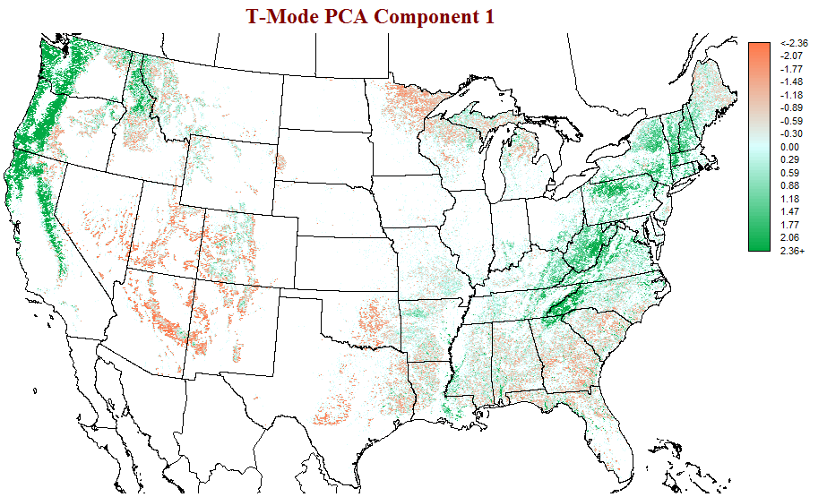
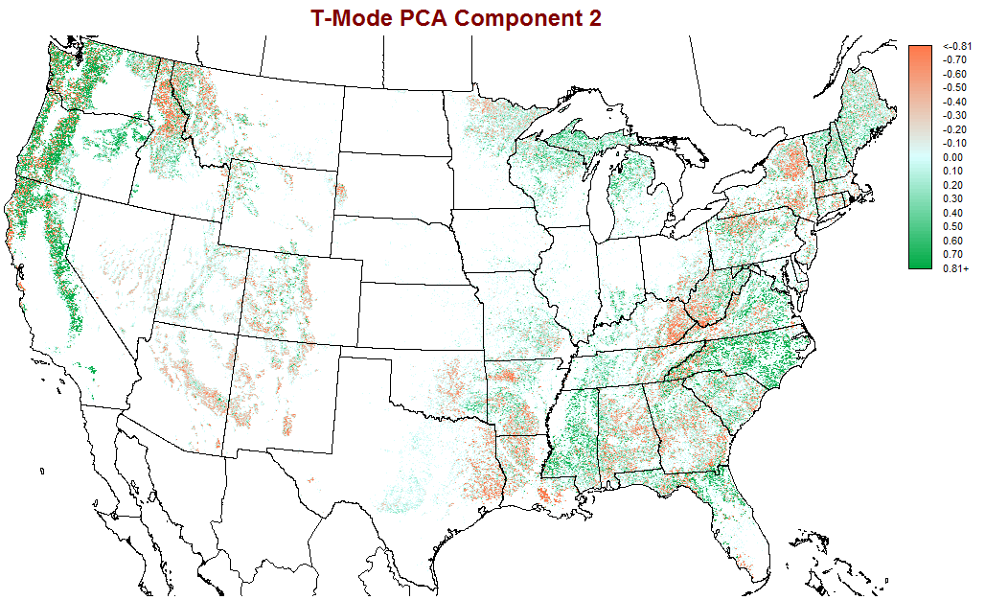
Spatial comparison 1
Spatial comparison: Examine map-wide variability at grain size of individual cells
Principal Component 1 (76.2% explained variance)
Principal Component 2 (9.33% explained variance)
-2.36
-0.81
0.81
Disagreement has spatial pattern
2.36
Patterns of agreement
Patterns of disagreement
Correlation Coefficient
Correlation Coefficient
Possible grain size effect?
Notes:
Talking points: The first principal component is essentially a map of biomass where all methods agree, and it jives with general expectations of biomass. High scores along this axis correspond to high biomass, low scores to low biomass.
Second component: Patterns of disagreement – both spatially and across maps. Maps that correlate highly with PC2 are contributing more to the patterns of disagreement among all maps.
This suggests that if you want to use the information at a grain finer than the whole country – for example, at the scale of individual modeling cells in your climate inversion? – the wrong map could in fact lead you astray.
Note two key things:
-- disagreement among maps is NOT random – there is distinct spatial pattern, with some regions showing much more disagreement than
First principal component shows the spatial pattern of biomass with higher biomass in west and east coast and lower biomass in south east and south west. The second principal component says about divergence. The second component has max correlation with Blackard et al. Suggesting this map disagrees with other three maps more often.

Slide 9
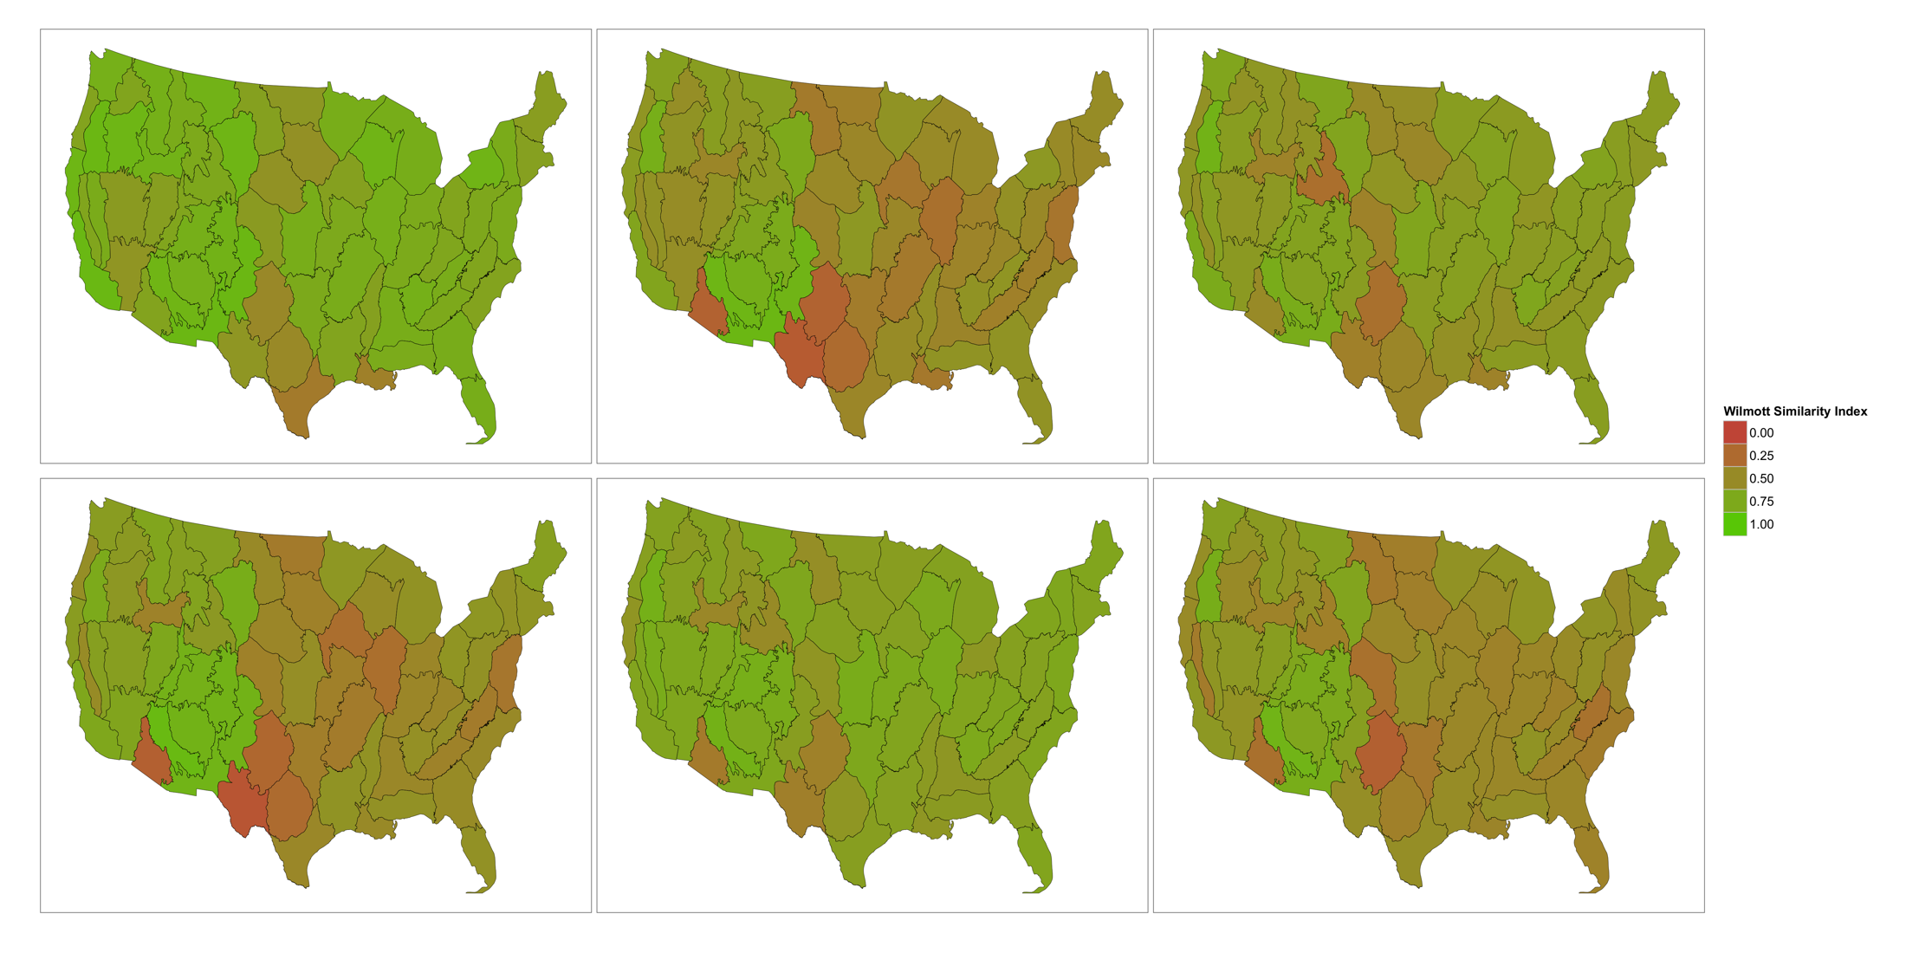
Spatial comparison 2
Saatchi et al. & Kellndorfer et al.
Saatchi et al. & Blackard et al.
Saatchi et al. & Wilson et al.
Next comparison: Examine pairwise contrasts among maps at pixel scale, summarize at ecoregion scale
Kellndorfer et al. & Blackard et al.
Kellndorfer et al. & Wilson et al.
Blackard et al. & Wilson et al.
Willmott’s Index of Agreement
Notes:
Next, we can examine pairwise agreement within each ecoregion and summarize at the national scale. Spatial patterns of disagreement suggest that the biomass maps disagree more in ecoregions with low tree biomass, although not exclusively. More generally, the three relatively consistent maps do tend to agree at the within-region scale except in some cases.

Slide 10
Spatial comparison
Next comparison: Summarize at ecoregion scale and report at national scale
Ecoregions outlined in black
Notes:
Pairwise 50-th percentile comparison. A third comparison is to examine agreement and disagreement summarized to ecoregions. Here, we examine distribution of biomass within each ecoregion. Underlying question: Is it appropriate to use biomass at this aggregated scale? These results suggest that it is. Interestingly, the grain size effect suggested by the PCA analysis is not present – in fact, the tightest agreement is between the Wilson and kellndorfer maps, which differ in grain size and methodology.

Slide 11
Low-biomass comparisons:
Ecoregion 10th-percentile
Notes:
The differences among maps appear to be more extreme at the low-biomass end of the spectrum. This is consistent with the observations from the within-ecoregion similarity index approach.

Slide 12
Regional scale maps

Slide 13
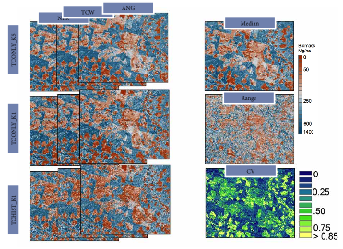
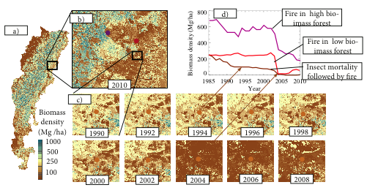
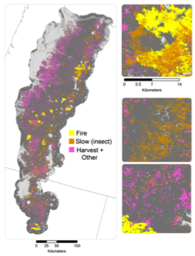
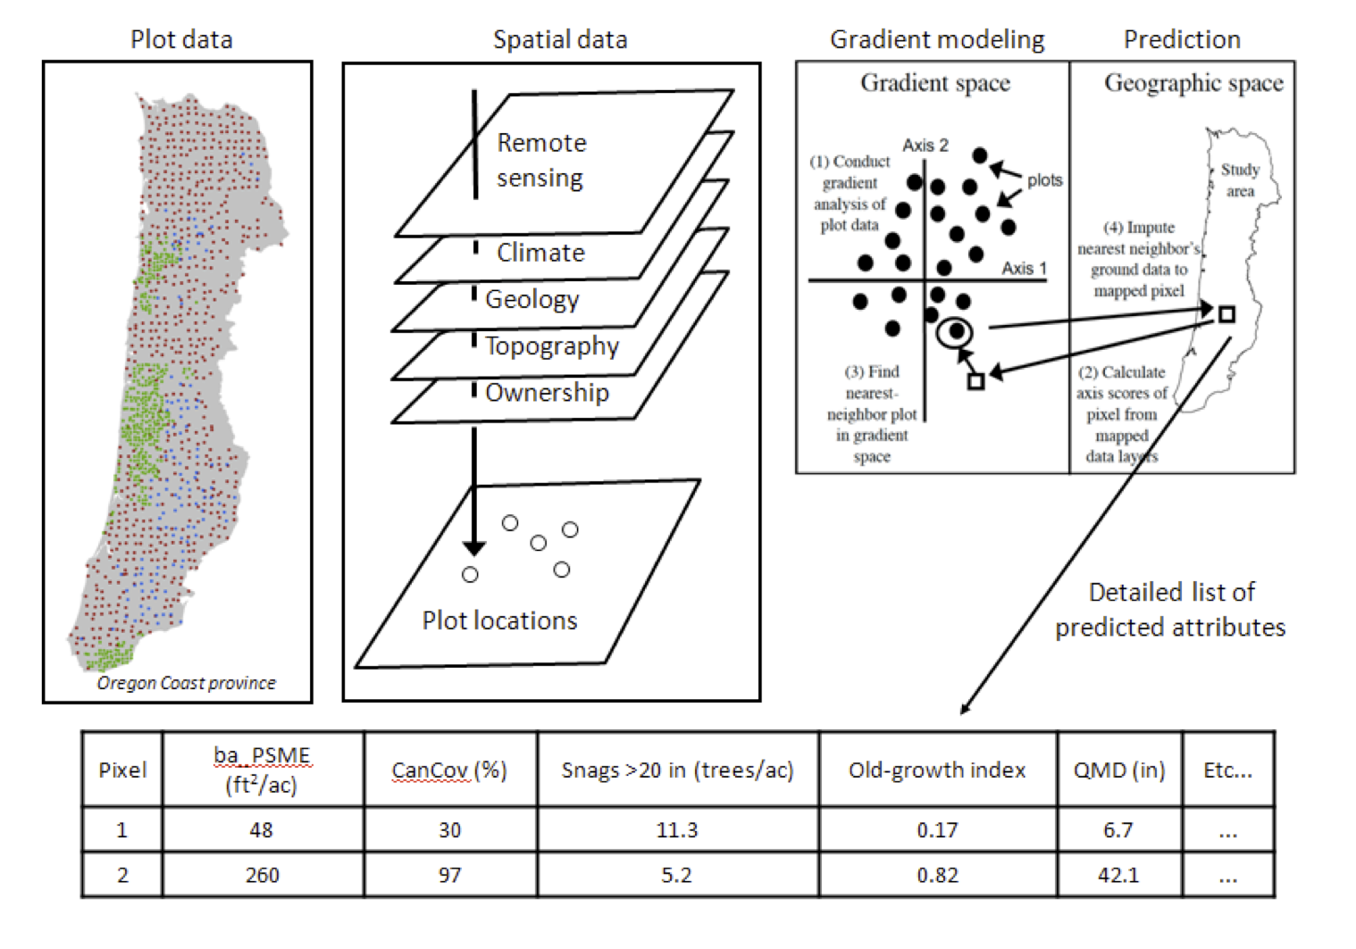
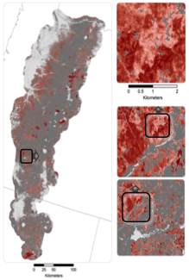
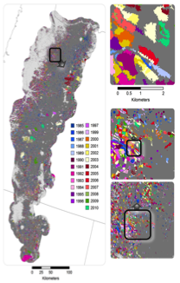
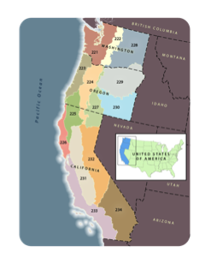
Regional carbon monitoring
Forest biomass
Airborne lidar
Yearly biomass
Methodological uncertainty
LandTrendr + FIA Plots
Science and Management Questions
Quantify landscape carbon dynamics and vulnerabilities
Evaluate natural and anthropogenic drivers
Evaluate efficacy of monitoring system
k=1
Disturbance year, magnitude, agent
Nearest-neighbor imputation

Slide 14
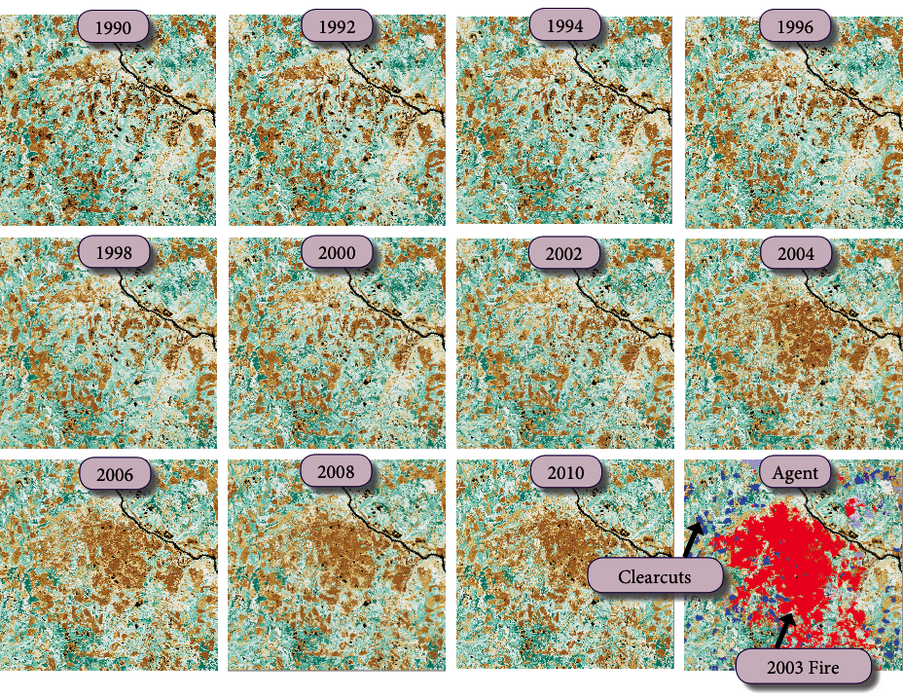
Regional carbon monitoring
sdfds
Yearly maps of biomass from 1990 to 2010, with methodological uncertainties, disturbance and agent of change

Slide 15
Integration
Temporal analysis: Use temporal richness at regional scale to develop expected change among national-scale maps
Biomass changes due to disturbance

Slide 16
Observed vs. expected
One example
Disagreement on off-axis condition suggests problems: disagreement not related disturbance

Slide 17
Summary
Comparing products
Preliminary definitions and processing needed to align datasets spatially
General agreement at broad spatial scales, but substantial disagreement at finer scales
Regional scale analyses can provide both direct comparisons and means of regularizing other products

